Slide 1

Department of Computer Science and Engineering
Deep Stroke Detect: Optimizing Stroke Risk Prediction Using SMOTEEN and Transfer Learning
PRESENTED BY
Shaik Nazeema (22471A05D3)
Parella Akhila (22471A05B4)
Diddi Sandhya (22471A0586)
Under the Guidance of,
Tupakula.Sai Sarnya_{M.Tech,}
Assistant Professor ,
Department of Computer Science and Engineering,
Narasaraopeta Engineering College (Autonomous),
Narasaraopet- 522 601.

Slide 2
OUTLINE
Abstract
Introduction
Literature Survey
Research Gaps
Problem Statement
Objectives
Block Diagram / Flow Diagram
Methodology
Implementation
Results and Analysis
Conclusion & Future Scope
References
Acknowledgements
Question and Answers

Slide 3
ABSTRACT
Stroke is a major global health issue and a leading cause of death and long-term disability, making early risk identification crucial for timely treatment and prevention.
This study proposes a Deep Learning–based Stroke Prediction Model designed to assess stroke risk using real-world healthcare datasets with significant class imbalance.
To handle the imbalance and improve data quality, the model incorporates SMOTEENN sampling, data preprocessing, and cross-validation, ensuring robust and unbiased learning.
Transfer Learning was applied to enhance model generalization and overcome limitations of scarce stroke data, improving the model’s adaptability.
The proposed model achieved 95.24% accuracy and 95.52% F1-score, proving that effective data preparation, intelligent preprocessing, and feature selection can significantly improve stroke prediction and aid doctors in early intervention.

Slide 4
INTRODUCTION
Brief Overview: Stroke is a major health concern causing death and disability, and early prediction using clinical data helps in timely prevention and treatment.
Motivation: To overcome the limitations of manual stroke diagnosis by using Deep Learning, SMOTEENN, and Transfer Learning for faster and more accurate predictions.
Relevance: The project provides an AI-based framework that improves real-time stroke risk detection, supporting modern intelligent healthcare systems.

Slide 5
LITERATURE SURVEY
No | Title | Author | Journal Name & Year | Methodology Adapted | Key Findings | Gaps
1 | A Hybrid Deep Learning Approach for Improved Detection of Ischemic Stroke Lesions | Gayatri Thakre, Rohini Raut, Chetan Puri & Pravin R. Patil | Applied Sciences (MDPI), 2025 | Hybrid CNN + RNN/LSTM combining spatial and sequential features | Improved lesion detection by merging CNN spatial and LSTM temporal features | Accuracy/AUC not clearly reported; limited external validation
2 | Automated Risk Prediction of Post-Stroke Adverse Events Using Deep Learning | Oei C.W., Ng E.Y.K., Ng M.H.S., Chan Y.M., Subbhuraam V. | 2025 — Bioengineering (MDPI) | Feed-forward DNN (MLP) with LSTM for sequential patient data | First DL model predicting post-stroke depression & mortality | Small dataset (n=179); no external validation

Slide 6
LITERATURE SURVEY
No | Title | Author | Journal Name & Year | Methodology Adapted | Key Findings | Gaps
3 | Ischemic Stroke Lesion Segmentation on Multiparametric MRI Using DenseResU-NetCTPSS | Ankit Kandpal, Rakesh K. Gupta, Anup Singh | AI Journal (MDPI), 2025 | Dense-Residual U-Net for lesion segmentation | Achieved Dice ≈ 0.65 (train), 0.47 (test) | No external validation beyond ISLES-2018 dataset
4 | Machine Learning and Deep Learning Algorithms for Stroke Prediction: A Meta-Analysis | Mahbod Issaiy, Diana Zarei, Shahriar Kolahi & David Liebeskind | Journal of Neurology (Springer), 2024 | Comparative meta-analysis of ML & DL models (LR, SVM, RF, GB, NN) | Gradient Boosting AUC ≈ 0.91; RF ≈ 0.83 | Only qualitative synthesis; heterogeneous datasets
5 | Optimized Deep Learning Models for Stress-Based Stroke Detection | V. [Author], 2025 | Discover Applied Sciences (Springer) | CNN–BLSTM hybrid optimized using metaheuristics | High accuracy using temporal–spatial EEG features | Dataset details unclear; no external validation

Slide 7
LITERATURE SURVEY
No | Title | Author | Journal Name & Year | Methodology Adapted | Key Findings | Gaps
6 | Machine Learning & Deep Learning Algorithms for Stroke Prediction (Review) | Issaiy, Zarei, Kolahi & Liebeskind | IEEE Access, 2024 | Review of ML/DL preprocessing and models (SMOTE, normalization, DL | Ensemble & DL methods outperform traditional scoring | Lack of transparency and reproducibility in reviewed studies
7 | A Novel Intelligent Healthcare System Based on Deep Recurrent Neural Networks | Saeed Mohsen & Ahmed Gomaa | Multimedia Tools & Applications (Springer), 2025 | BiLSTM model with data cleaning & imbalance handling | 100% testing accuracy, precision, recall, and F1-score | Small dataset (n=4,981); possible overfitting

Slide 8
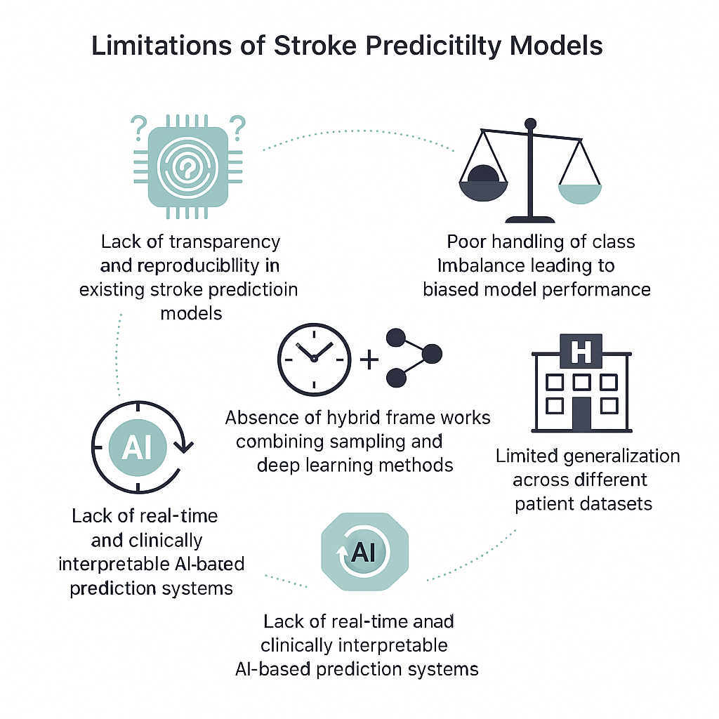
RESEARCH GAPS
Lack of transparency and reproducibility in existing stroke prediction models.
Poor handling of class imbalance leading to biased model performance.
Limited generalization across different patient datasets.
Absence of hybrid frameworks combining sampling and deep learning methods.
Lack of real-time and clinically interpretable AI-based prediction systems.

Slide 9
PROBLEM STATEMENT
Problem Definition:
Stroke is a major global health issue, and early prediction remains challenging due to imbalanced datasets and low model transparency.
Existing manual and AI-based systems often show inconsistent accuracy and poor generalization across diverse patient data.
Significance of the Problem:
Early and reliable stroke prediction can save lives and reduce long-term disabilities through timely medical intervention.
An automated and explainable deep learning framework enhances clinical trust, accuracy, and real-time decision support in healthcare.

Slide 10
OBJECTIVES
To develop an automated deep learning model for accurate stroke risk prediction using clinical and lifestyle data.
To handle data imbalance effectively using the SMOTEENN sampling technique for fair and balanced prediction.
To enhance model performance and generalization through the use of Transfer Learning.
To build an explainable and scalable AI framework that supports real-time clinical decision-making.

Slide 11
BLOCK DIAGRAM OR FLOW DIAGRAM
Data Collection (Kaggle stroke prediction dataset)
Data Preprocessing(Handle missing values,encoding,normalise)
SMOTEENN Sampling(balance classes)
ModelEvaluation (Accuracy,Recall,F1 score,Precision)
Prediction Output(Stroke/No-Stroke)

Slide 12
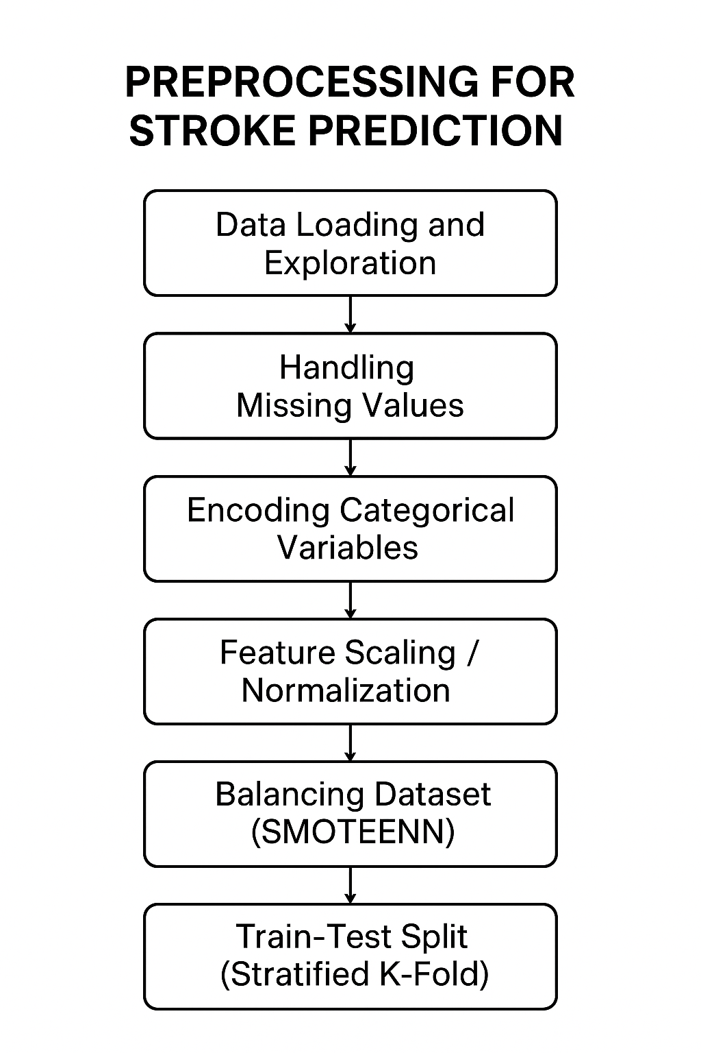
METHODOLOGY
Preprocessing Steps:
Data Cleaning:
Removed duplicates and irrelevant records.
Handled missing values (e.g., BMI, smoking status) using mean/mode imputation.
Encoding Categorical Features:
Converted columns such as gender, work_type, residence_type, and smoking_status into numeric form using Label Encoding.
Feature Scaling:
Applied Min–Max Normalization (0–1 scaling) to standardize features like age, glucose level, and BMI for stable model training.

Slide 13
METHODOLOGY
Used histograms and boxplots to understand feature distributions.
Feature Correlation:
Generated a heatmap to analyze relationships among features and remove redundant ones.
Feature Selection:
Retained key predictors (age, hypertension, heart_disease, glucose_level, BMI, smoking_status) based on correlation and importance scores.
Data Balancing (SMOTEENN):
Used SMOTEENN to oversample minority (stroke) cases and clean noisy data, ensuring a balanced and unbiased dataset for training

Slide 14
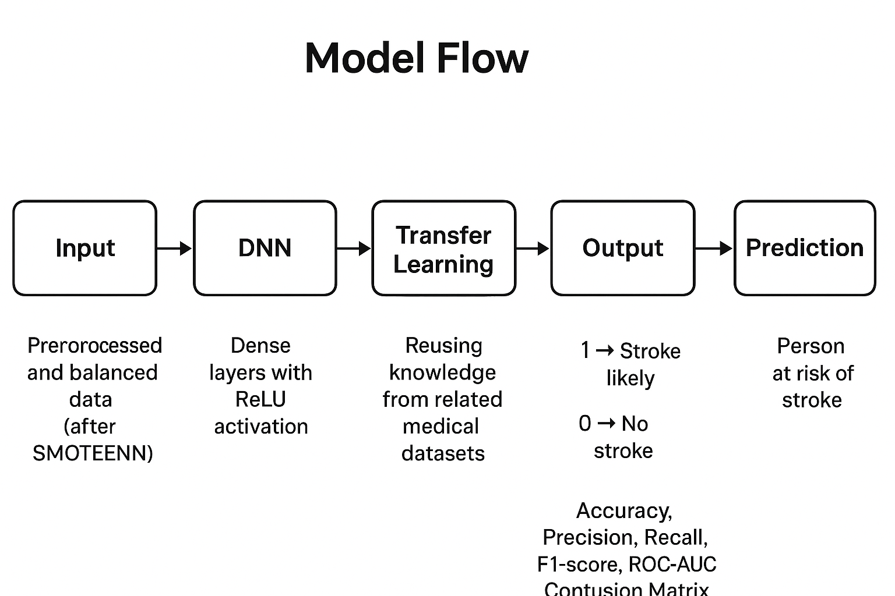
METHODOLOGY

Slide 15
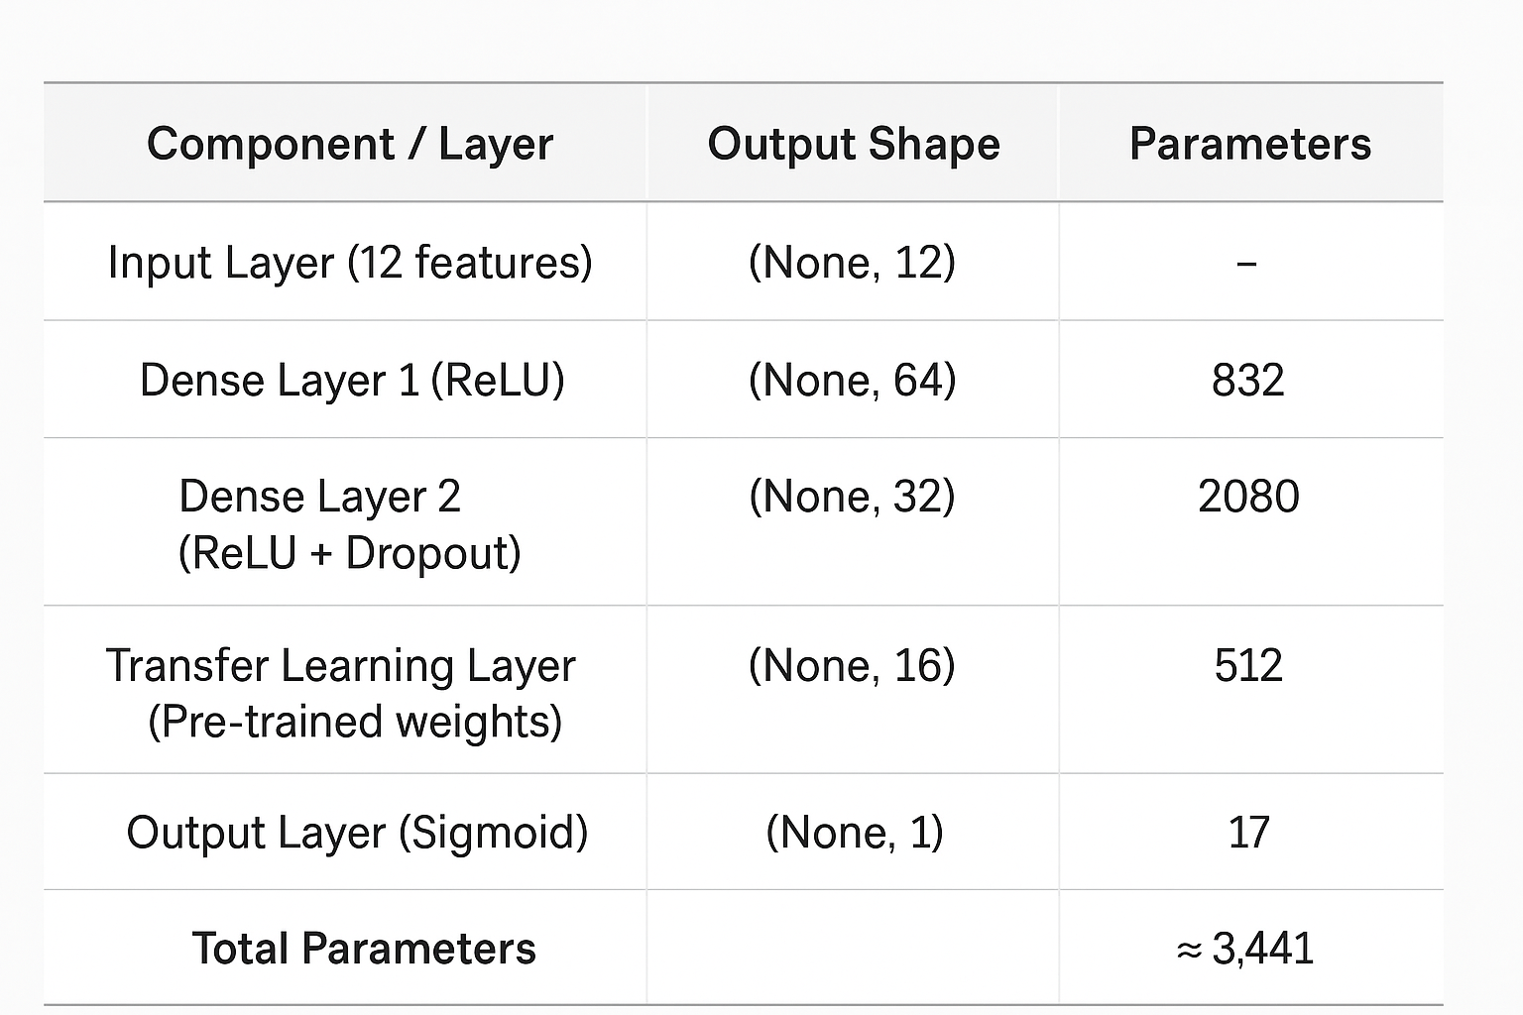



Framework Used:- Deep Neural Network (DNN) with Transfer Learning
Combines deep learning power with knowledge reuse from pre-trained models.
Enhances accuracy and generalization even on limited stroke datasets.
Works effectively with tabular medical data after preprocessing and balancing (SMOTEENN)
Reduces training time and improves model stability.
$$z=W×x+b$$
$$f\left(z\right)=max⁡(0,z)$$
$$f\left(z\right)=1÷(1+e^{−z})$$
L=−[ylog(y^​)+(1−y)log(1−y^​)]
W=W−η∂W∂L​

Slide 16
Implementation
The Deep Stroke Prediction System was implemented using a Deep Neural Network (DNN) with Transfer Learning and SMOTEENN sampling for balanced data. The model was trained, validated, and tested on the Kaggle Stroke Prediction Dataset using TensorFlow and Keras frameworks.
Data preprocessing and feature encoding
Balancing dataset using SMOTEENN
Model training with Transfer Learning
Evaluation using performance metrics
Prediction output visualization

Slide 17
System Requirements
Hardware Requirements
Processor : intel Core i5
Cache memory : 4MB(Megabyte)
RAM : 12.7GB (gigabyte)
Hard Disk : 166.8GB
Compute Engine : T4 GPU
Software Requirements
Operating System : Windows 10, 64-bit Operating System
Coding Language : Python
Python distribution : Google Colab , Flask
Browser : Any Latest Browser like Chrome

Slide 18
Challenges Vs Overcomes
Challenges Faced | Solutions Implemented
Challenges Faced | How They Were Overcome
1. Imbalanced dataset – The stroke cases were far fewer compared to non-stroke cases, causing biased predictions. | Applied SMOTEENN (combination of oversampling + cleaning) to balance the dataset and improve fairness in learning.
2. Overfitting of model – Model performed well on training data but poorly on testing data | Introduced Dropout layers, regularization, and cross-validation to reduce overfitting and improve generalization
3. Slow convergence during training – Model took longer to reach optimal accuracy. | Used the Adam optimizer with an optimal learning rate of 0.001, ensuring faster and smoother convergence.
4. Limited dataset and fewer features – The dataset had restricted information and small sample size. | Integrated Transfer Learning to reuse pre-trained weights, improving learning efficiency and accuracy.
5. Lack of interpretability – Model predictions were difficult to understand for medical use. | Added feature importance visualization and evaluation metrics (ROC, F1, Precision, Recall) to enhance explainability.

Slide 19
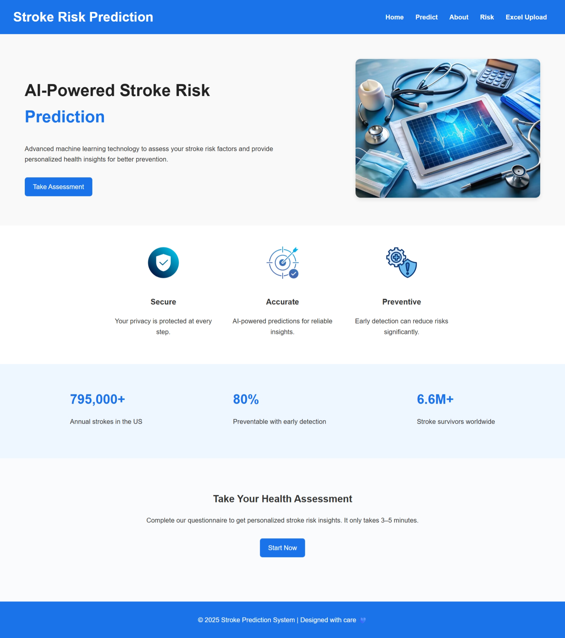
Implementation of Frontend

Slide 20
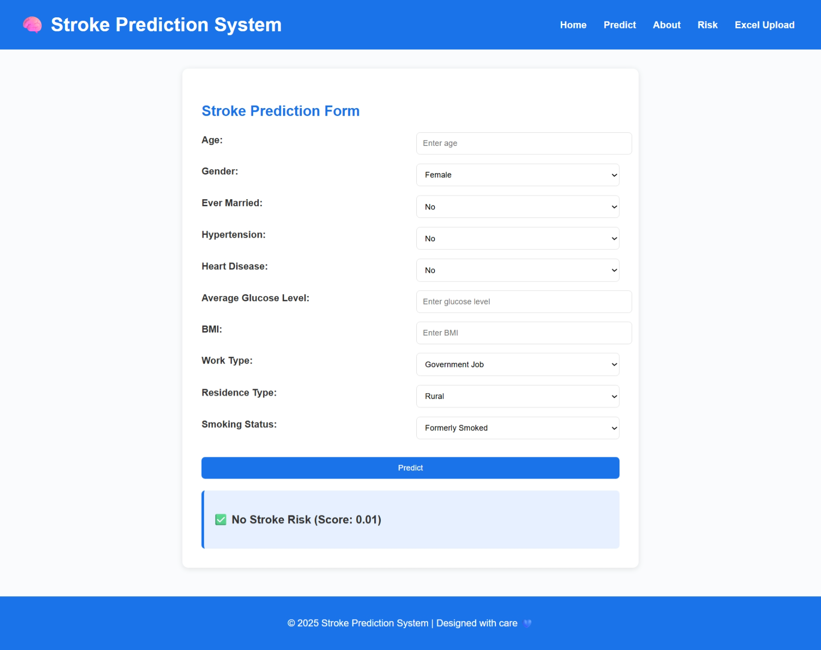
Implementation of Frontend

Slide 21
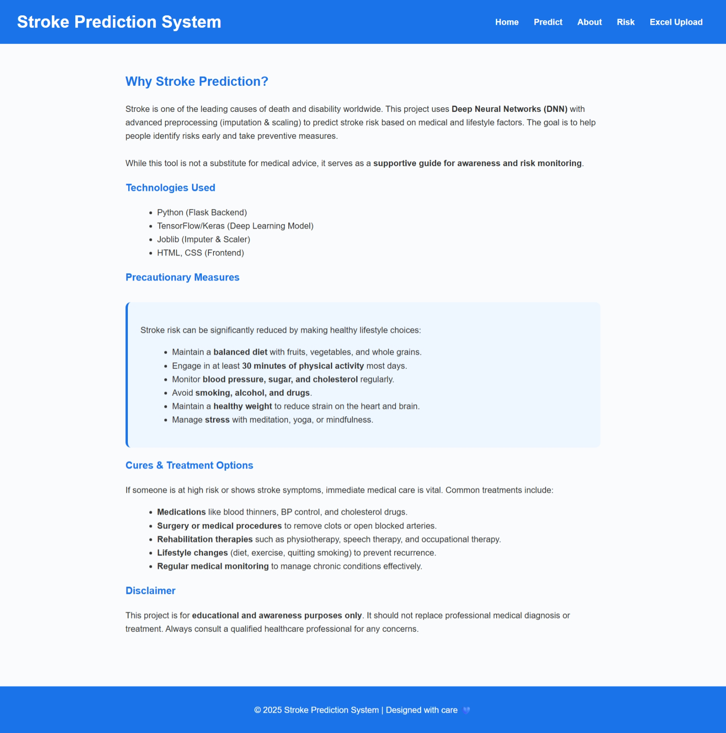
Implementation of Frontend

Slide 22
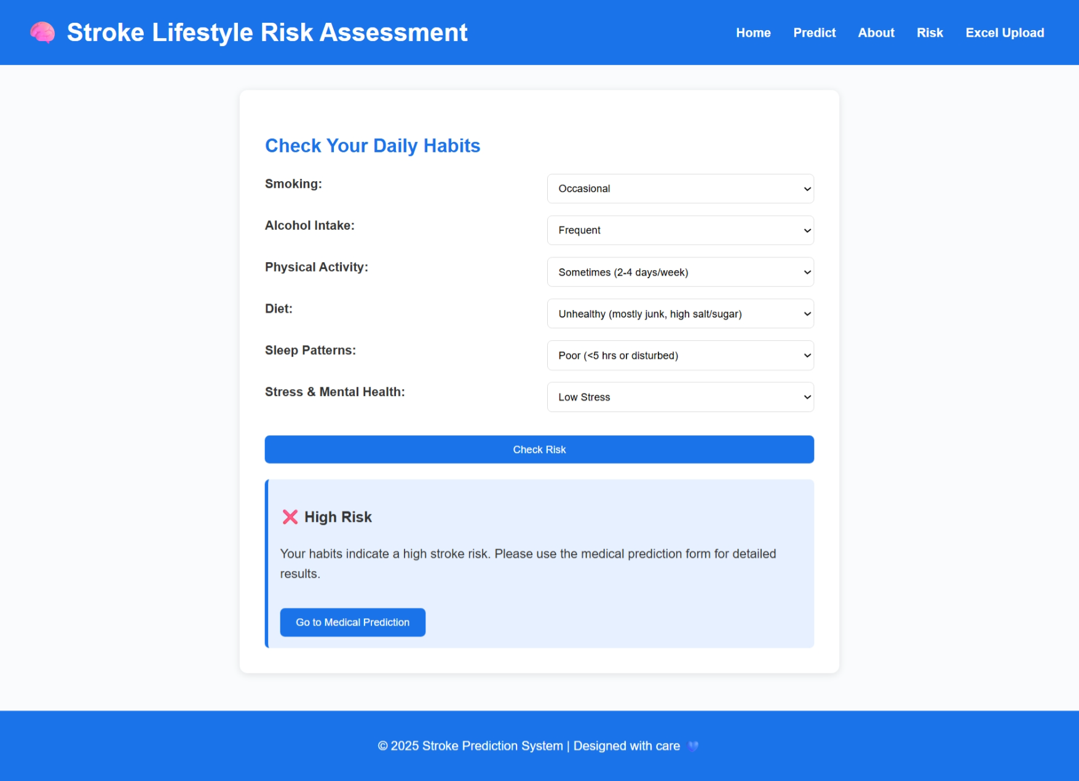
Implementation of Frontend

Slide 23
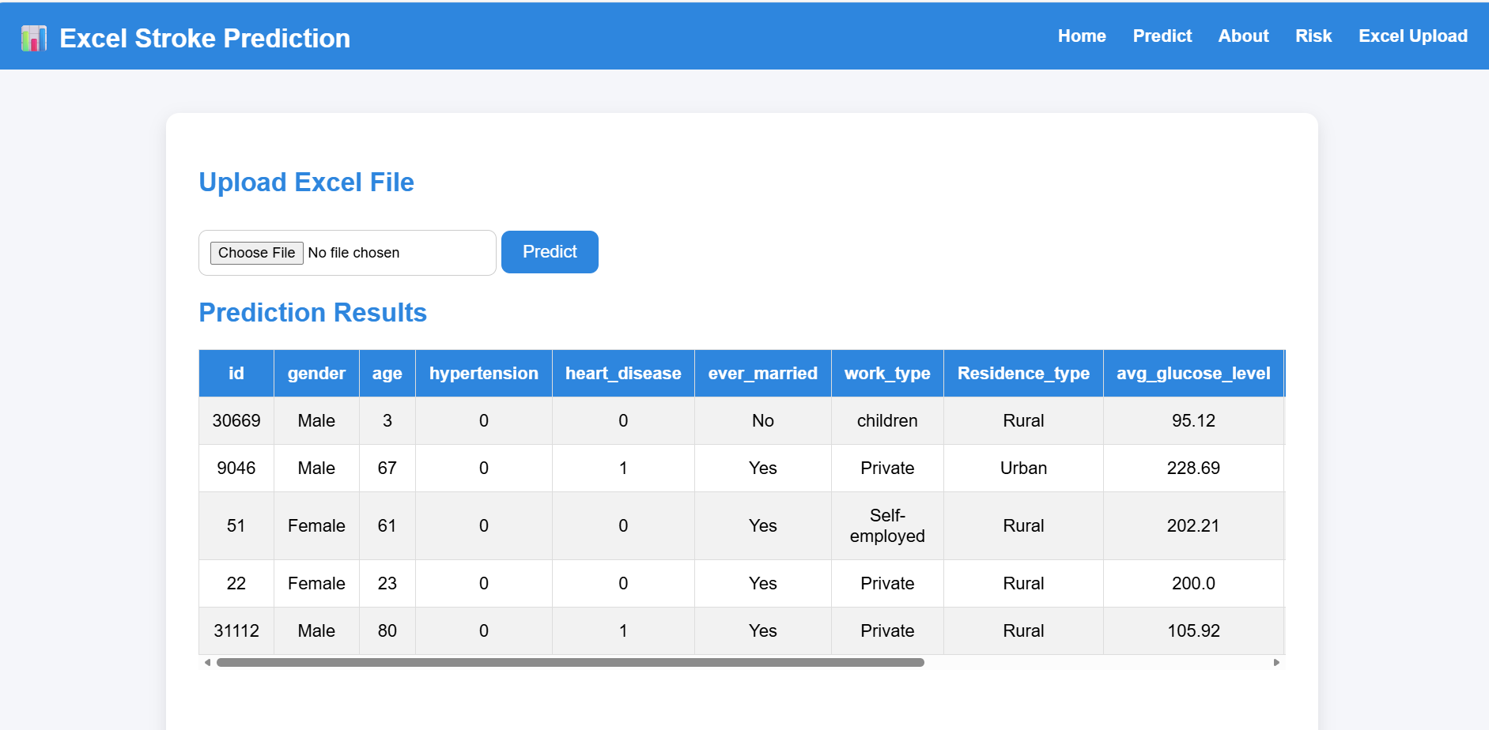
Implementation of Frontend

Slide 24
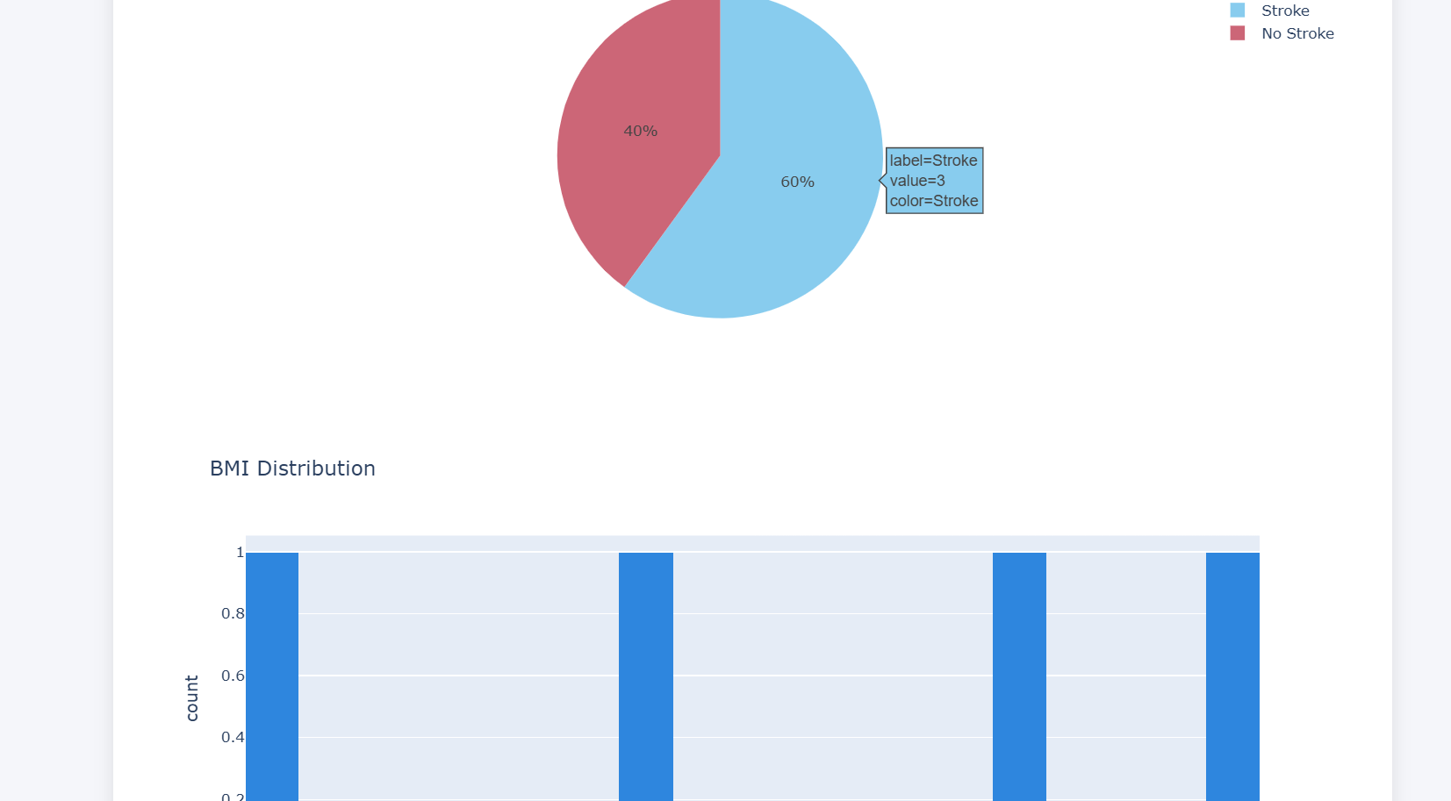
Implementation of Frontend

Slide 25
RESULTS & ANALYSIS
Model | Accuracy | Precision | Recall | F1-Score
TL-DNN | 95.3% | 93.6 | 97.69 | 98.6
Logistic Regression | 82.31 | 82.46 | 82.03 | 82.24
Decision Tree | 87.54% | 86.37 | 88.33 | 87.34
Random Forest | 91.12% | 90.42 | 91.87 | 91.14
KNN | 88.21 | 87.42 | 89.06 | 88.23
SVM | 90.25% | 89.69 | 90.82 | 90.25
XGBoost | 93.34 | 92.76 | 94.12 | 93.43
The proposed TL-DNN model achieved the highest performance among all compared models, attaining an impressive accuracy of 95.3%, which surpasses traditional machine learning models such as XGBoost (93.34%), Random Forest (91.12%), and SVM (90.25%).

Slide 26
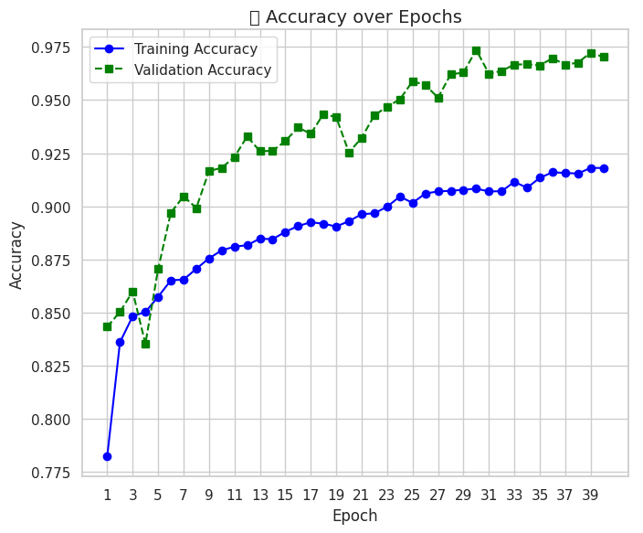
RESULTS & ANALYSIS
The training and validation accuracies of the TL-DNN model consistently improve over epochs, reaching around 95% and 97% respectively, showing strong learning capability and reliable generalization.
The close alignment of both curves indicates that the TL-DNN model effectively avoids overfitting while maintaining high validation performance across epochs.

Slide 27
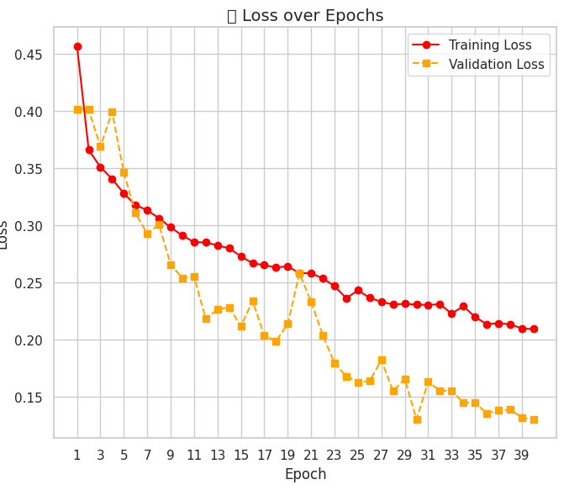
RESULTS & ANALYSIS
Both training and validation losses decrease steadily, with validation loss dropping below 0.15, reflecting efficient optimization and robust model convergence.This hints at good generalization and no signs of overfitting.
The stable reduction in loss values throughout training suggests that the TL-DNN model learned meaningful features without significant variance or instability.

Slide 28
CONCLUSION & FUTURE SCOPE
Conclusion:
The proposed Deep Stroke Prediction model achieved 95.28% accuracy, effectively identifying stroke risk early.
The use of SMOTEENN improved learning from imbalanced data, ensuring fair and reliable predictions.
The model consistently performed well across multiple data checks, reducing the chance of missed stroke cases.
Future Scope:
Validate the model using data from multiple hospitals to ensure clinical reliability.
Develop systems that analyze brain scan images (MRI/CT) for deeper stroke insights.
Create doctor-friendly explainable interfaces to improve trust and ease of use.
Integrate the system into hospital networks for real-time stroke risk monitoring and quick medical response.

Slide 29
REFERENCES
W. H. O. Dr Hanan Balkhy, “Stroke, cerebrovascular accident,” World Health Organization, 2024.
V. L. Feigin, B. Norrving, and G. A. Mensah, “Global burden of stroke,” Circulation Research, vol. 120, no. 3, pp. 439–448, 2017.
B. C. V. Campbell, “Ischaemic stroke: Pathophysiology and principles of treatment,” International Journal of Stroke, vol. 14, no. 6, pp. 574–584, 2019.
D. Mukherjee and A. Patil, “Early prediction of stroke using machine learning and deep learning models,” IJETER, vol. 8, no. 5, pp. 1946–1951, 2020.
A. Mirajkar, “Stroke prediction using machine learning techniques,” International Journal of Engineering Research and Technology, vol. 9, no. 6, pp. 382–386, 2020.
X. Liang, “Stroke prediction using deep learning,” BioMed Informatics, vol. 20, no. 4, pp. 243–251, 2022.
H. Nair, “CNN-based stroke risk prediction using smartwatch-generated physiological data,” Sensors, 2024.
Y. Tanaka, “Real-time stroke prediction using wearable sensor data and LSTM networks,” IEEE Journal of Biomedical and Health Informatics, 2024.
M. Park, “IoT-enabled stroke monitoring and prediction using Bi-LSTM model,” IEEE Access, 2024.
S. Ali, “Stroke prediction using feature selection and XGBoost on Kaggle dataset,” Proceedings of the International Conference on Health Informatics (ICHI), 2024.
S. Mamidala, S. Moturi, S. Rao, J. Bolla, and K. Reddy, “Machine learning models for chronic renal disease prediction,” in Data Science and Applications. ICDSA 2023, Springer, Singapore, 2024, vol. 819, pp. 291–301.
S. L. Jagannadham, K. L. Nadh, and M. Sireesha, “Brain tumour detection using CNN,” in 2021 Fifth International Conference on I-SMAC (IoT in Social, Mobile, Analytics and Cloud), Palladam, India, 2021, pp. 734–739.
A. Seva, S. N. Tirumala Rao, and M. Sireesha, “Prediction of liver disease with random forest classifier through SMOTE-ENN balancing,” in IEEE 13th International Conference on Communication Systems and Network Technologies (CSNT), Jabalpur, India, 2024, pp. 928–933.
K. V. N. Reddy, “Automated traffic sign recognition via CNN deep learning,” in IEEE IATMSI, 2025.
I. Kavakiotis, “Machine learning and data mining methods in diabetes research,” Computational and Structural Biotechnology Journal, vol. 15, pp. 104–116, 2017.

Slide 30
ACKNOWLEDGEMENTS
We would like to express our sincere gratitude to the faculty and staff of Narasaraopeta Engineering College for their guidance and encouragement throughout the development of this project. Their insights and expertise have been invaluable.
We also extend our thanks to the administration for providing the necessary resources and a platform to showcase our work. This opportunity has been instrumental in enhancing our learning and growth.
For any questions or further discussions, feel free to reach out:-
Team No:BG11
Guide: Tupakula Sai Sarnya
Roll No’s: 22471A05D3
22471A05B4
22471A0586

Slide 31


Slide 32
Thank You

